Slide 1
YACS
How to: Github

Slide 2
Pulling Requests

Slide 3
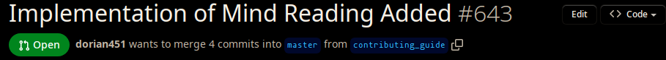
How to review a pull request
Find a pull request.
Find the name of the branch in the pull request:
Open a terminal and navigate to your local repository (the yacs.n folder)
Make sure your computer's repo is up to date by running git pull.
branch name would be contributing_guide

Slide 4
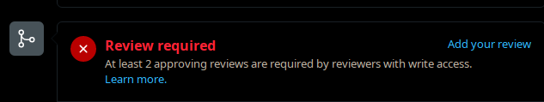
How to review a pull request
Run git switch <branch name>.
On some computers, if you are running the local version of YACS already, it will update automatically. If it doesn't, restart Docker and refresh the localhost page.
Look at the pull request and verify that whatever functionality it adds works and doesn't seem to cause any problems.
Add your review (whether it's an approval or not) hitting the "add your review" button:

Slide 5
Opening Issues

Slide 6
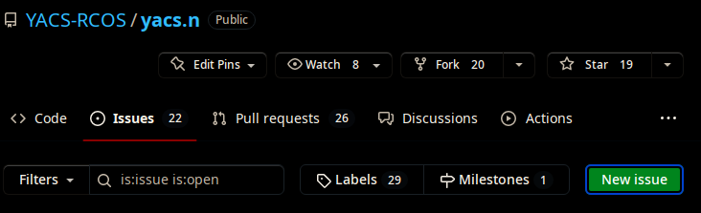
Opening an Issue:
Go to issues and hit "New Issue":

Slide 7
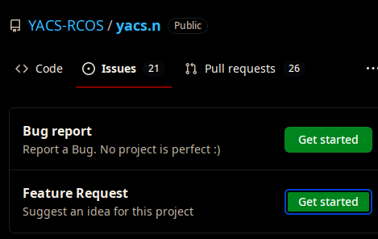
Opening an Issue:
2. Hit "Feature Request":

Slide 8
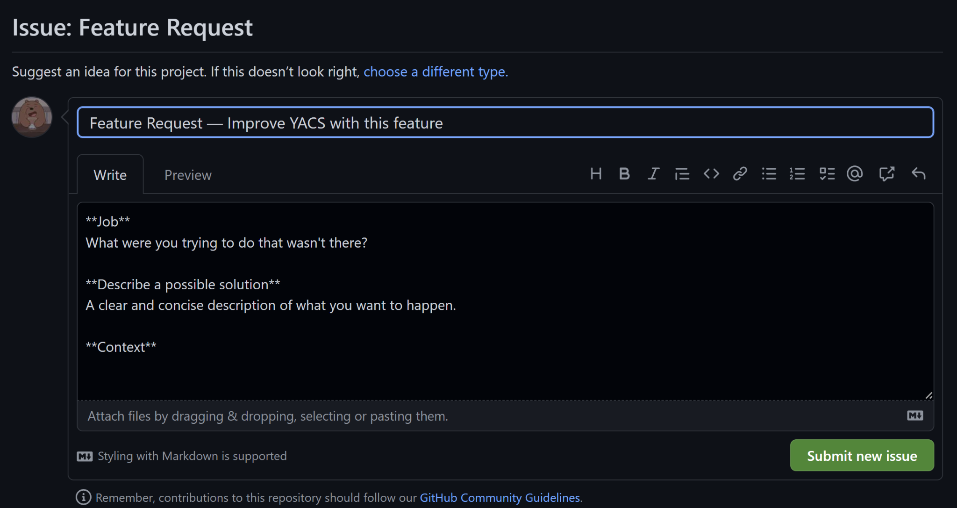
Opening an Issue:
3. Fill out the template (make sure to add the appropriate labels/projects!):
4. Hit submit issue once you’re done.

Slide 9
Working on Issues

Slide 10
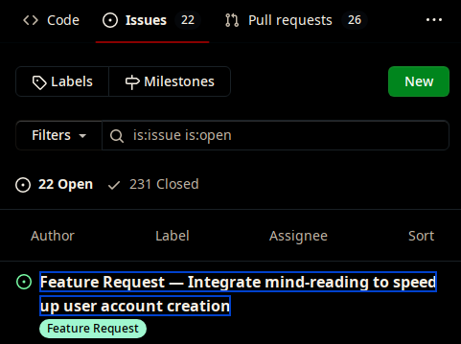
Working on an issue:
1. Find an issue you want to work on and open it:

Slide 11
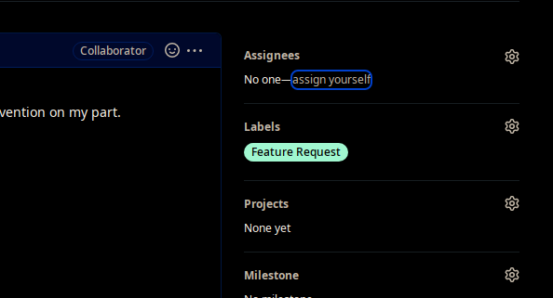
Working on an issue:
2. Assign yourself to the issue:

Slide 12
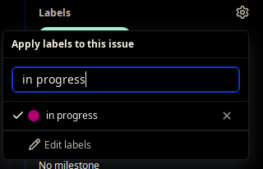
Working on an issue:
3. Add the "in progress" label:

Slide 13
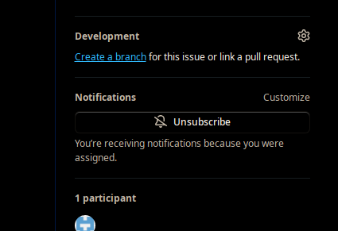
Working on an issue:
4. Create / assign a branch to the issue:

Slide 14
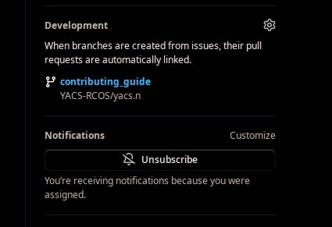
Working on an issue:
5. When done, make a pull request:
click the branch name in the issue

Slide 15
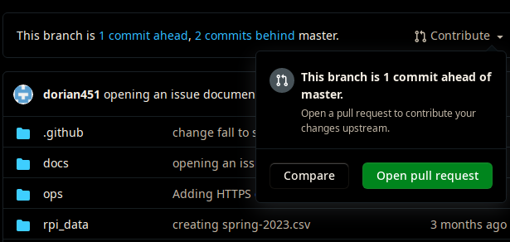
Working on an issue:
5. When done, make a pull request:
Hit "Contribute", then hit "Open pull request"

Slide 16
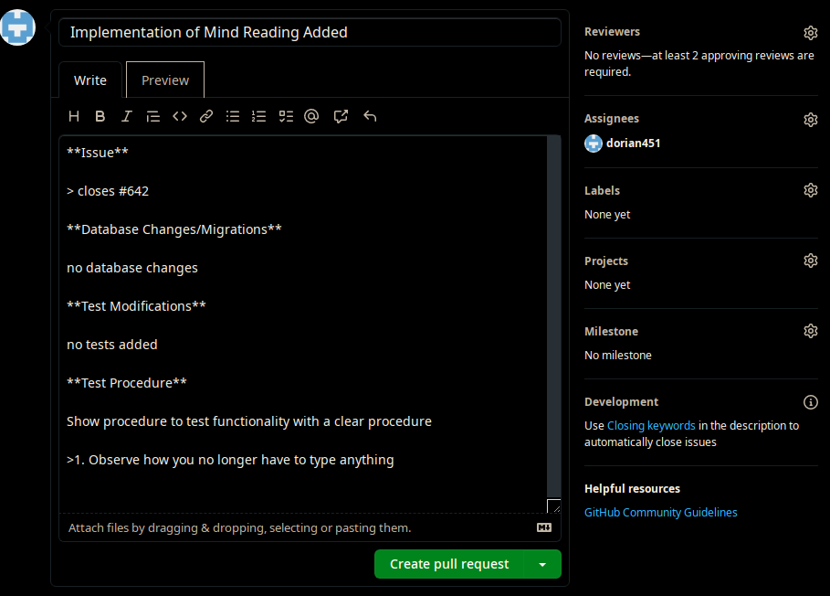
Working on an issue:
5. When done, make a pull request:
Fill out the template and, when ready, hit "Create pull Request": (make sure to assign yourself in the Assignees section!)

